Slide 1


Riptide Elements®
Jhorlin DeArmas
Lead Engineer / Architect
Riptide Software, Inc.
200 East Palm Valley Drive
Oviedo, FL 32765
A Configurable Learning Services Environment

Slide 2
Platform Requirements
Scalable
Redundant
High Availability
Durable
Multi-tenant

Slide 3
Elements AWS Philosophy
Managed services over custom instances.
Using a manages services in most cases will reduce the time when integrating a service.
Reduced cost since managed services are less expensive then building the service on ec2 instances.
Reduced cost since there are no service instance to maintain.
There is more one way to use a service.
The same AWS service can be used for different unrelated tasks, think out side the box, scour the internet, discuss your ideas with co-workers and profile your use of the service.

Slide 4
Scalability
The ability of a system, network, or process to handle a growing amount of work in a capable manner or its ability to be enlarged to accommodate that growth.
When creating a service for a platform where scalability is required it is easier to split the platform into small services and focus on a specific feature of the platform.
Loosely coupled services can scale independently.
Small services can be repurposed.
Creation and destruction of smaller services is generally faster.
Easier to maintain and deploy.
Microservices
A software architecture design pattern, in which complex applications are composed of small, independent processes communicating with each other using language-agnostic APIs. These services are small, highly decoupled and focus on doing a small task.

Slide 5






Elements AWS Microservice aproach
We use a similar approach for all of our micro services and continue to build up by consuming more aws services.
In a vpc create a private and a public subnet.
Run all application service in the private subment
Run all web services in the public subnet
Use Elastic Beanstalk to setup our environment, auto scale group elastic load balancer and manage instance across availability zones.
Share state via elasticache.
Memcached elasticache
Elastic Load
Balancing
Web Instances
Auto Scaling group
Elastic Beanstalk container
Private VPC subnet

Slide 6
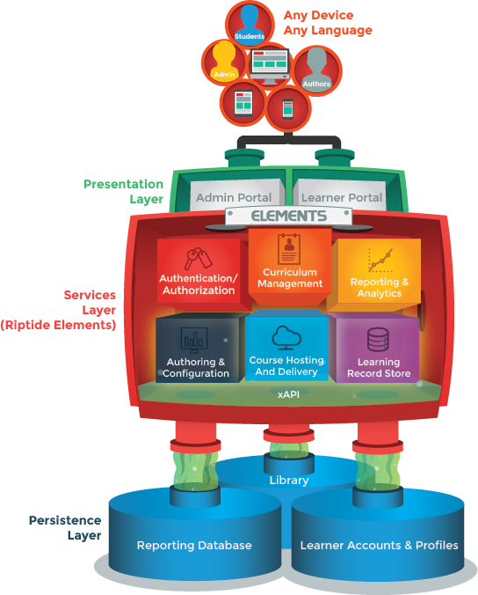
Elements Web Services
With a basic template for our micro service we are now able to add new services.
Each of our service handles a feature or our learning platform and we identify each service with a base path.
Our services include
/learn (delivers learning content)
/lrs (learning record store service for tracking)
/authenticate (authenticate and user management)
/config (configure course and delivery app)
/author (author course)
/teach (curriculum management service)
/share (social media integration and collaboration)

Slide 7
Redundancy
Duplication of critical components or functions of a system with the intention of increasing reliability of a system
Most of AWS managed services offer redundancy either by default or through configuration
With auto scale groups you are able to scale across multiple AZ
It is recommended that for any production service you have at least two instance spread across availability zones
It is important to understand the limitations of any managed service which you use.
ElastiCache clusters are available in one availability zone.
For redis you have to create read replicas in different AZ’s.
Memcached needs to be configured for clustering.
Each instance needs to connect to its AZ’s node.

Slide 8
High Availability
System availability = (total time – down time) / total time
(525949(minutes in a year) – 10080(minutes in a week)) / 525949
= .98 or 98% that one nine
Consider AWS’s SLA’s
S3 99.9% aws.amazon.com/s3/sla but designed for 99.99%
EC2 99.95% aws.amazon.com/ec2/sla
RDS 99.95% aws.amazon.com/rds/sla
By using AWS as you infrastructure for your application all you need to worry about is that your application is deployed and ready to respond.

Slide 9
Durability
The probability that an item will remain intact and accessible.
S3 defined durability as : “the probability that the object will remain intact and accessible after a period of one year.”
S3 durability is an astonishing 99.999999999%
If you store 10,000 objects in s3, on average you may loose one of them every 10 million years.
Many of AWS’s services rely on s3 to increase its own durability.
Example Elastic block storage can perform snapshots on your data and store it on S3 leveraging its high availability and durability.

Slide 10
Multi-tenancy
There are many ways to implement multi-tenancy and the implementation is left to your specific needs.
You can share data with multiple tenants or Isolate it.
There are many services which allow you decouple your code and Isolate your tenant but there are also services which require you to share.
Lets take a look at elements most challenging multi-tenant service, the lrs and see how we approached this problem.

Slide 11










LRS
Create a scalable web service.
Session State
Decouple tenant messages by publishing statement to a unique topic.
Internet
Queue depth
Keep track of what messages were processed.
Statements processed
Store statements in a queue.
LRS
Web
Service
Create a data store to persist our statements.
statements queue
Create a scalable worker service to process the queue and store the data.
public subnet
Monitor the queue depth and scale accordingly.
Monitor Throughput exceptions and push them into a queue.
Tenant topics
Increase the provisioning on Dynamo and watch for a decrease in throughput.
Workers
SNS
Worker auto scaling group
Create an s3 bucket for your web services assets and create a folder per tenant.
Workers ENV
Tenant table
Throughput exception
Create bucket with folder per client
Provisioning worker
Exception queue

Slide 12
Integration Strategy
We have a strategy of building scalable micro services.
We have a strategy to handle multi-tenancy.
We need a method to identify a tenant on our platform.
User subdomain as the tenant identifier.
On the elements platform Apple would be apple.elmnts.com
We need a way to identify the service a tenant is requesting.
Use path to specify a service
On the elements platform if Apple were going to authenticate will look like apple.elmnts.com/authentication

Slide 13



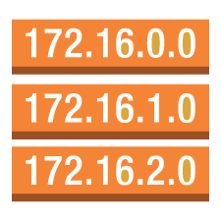
Putting it all together
/lrs
Deploy our services
Create a cloud front distribution
Add all your services and AWS services as origins.
Add behaviors so that your distribution will route to the appropriate service based on path.
Since we plan on identifying tenant by subdomain we need to set our behavior to pass the host header.
Add the alternate cname.
For elements it is *.elmnts.com
/authenticate
apple.elmnts.com
CloudFront
/learn
coke.elmnts.com
In route53 create a hosted zone
Add the domain for your hosted zone
For elements it is elmnts.com
Create a record set for each tenant
Example apple.elmnts.com
Alias the record set to cloudfront
Example somestrangekey.cloudfront.net
Bucket with tenant objects
/config
visa.elmnts.com
/author

Slide 14
Questions:
Jhorlin DeArmas
Lead Engineer / Architect
Riptide Software, Inc.
200 East Palm Valley Drive
Oviedo, FL 32765
Jhorlin.dearmas@riptidesoftware.com
www.riptidelearning.com
Twitter @riptidelearning

